Slide 1
Micro- Credit Defaulter
Under the guidance of
“Flip Robo-Technologies”
by
Harshitha K.S

Slide 2
Problem Statement
To classify if the user will default the loan using the user’s finance history.
This means given a set of new predictor variables, we need to predict the variable as :
Label:1:Flag indicating the user paid back the credit amount within 5 days of issuing the loan
Label:0:Flag indicating the user not paid back the credit amount within 5 days of issuing the loan

Slide 3
Tools used
Python
Jupyter notebook

Slide 4
Software Requirement
Python
Jupyter notebook
Numpy
Pandas
Seaborn
Scikit-learn

Slide 5
EDA Steps
Data collection:-lending data from the csv file. The dataset contains 209593 entries
Data preparation:-out of 37 features, we have removed categorical variable using the label encoding and drop method
Analysis and Modelling:-
1. Data will be divided into training and testing data.
2.This model will be developed on the training data and developed on the testing data.
3. The Visualization is done using the scatter-plot using seaborn library

Slide 6
Assumptions made
Assumption made:-
1. Positive examples :- the flag indicating the user paid back the credit amount within 5 days of issuing the loan(1)- success
2. Negative examples:- the flag indicating the user have not paid credit amount within 5 days of issuing the loan(0)- Failure
Output obtained:-
Positive examples = 183431
Negative examples = 26162
Proportion of positive to negative examples = 70.11%

Slide 7
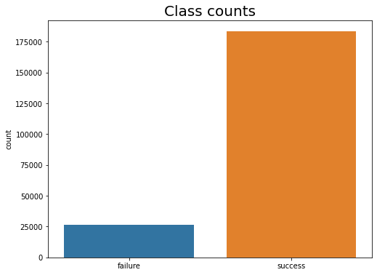
Plot Obtained after assumption made
there are 1,83,431 user paid back the credit amount within a 5 days of issuing
a loan
there are 26,162 user not paid back the credit amount within a 5 days of
Issuing a loan

Slide 8
Conclusion
Microfinance has been globally accepted as the preferred medium to reach out to the rural and productive poor with banking services which includes micro credit to help alleviate poverty
Micro credit default has been identified to be one of the major drawbacks of this laudable initiative as it depletes these revolving funds and reduces investors’ confidence.
Therefore, it is important to understand the factors that influence a loan beneficiary to default so that appropriate counter measures can be developed to prevent and reduce the incidents of default
In this project default prediction is done using Random Forest Classifier and decision tree.

